Slide 1
Chapter 19: Diode Applications (Part 2)
Power Supply Filters
Copyright © 2010 Christopher Teoh, Tan HJ & Wong WY Singapore Polytechnic. All rights reserved.

Slide 2
Objectives
After completing Part 2 of this chapter, you will be able to:
Understand the function of a power supply filter circuit
Explain how a capacitor filter works
Understand ripple voltage and ripple factor

Slide 3
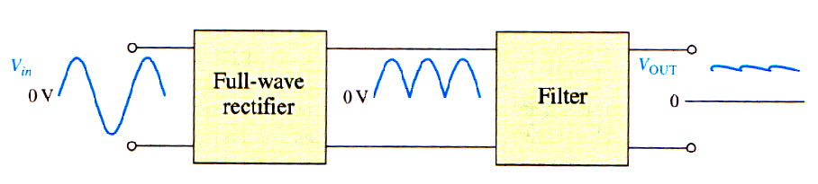
19-3 Power Supply Filters
Filtered Output
A power supply filter eliminates (or reduces) fluctuations in output voltage of a rectifier
It produces a (near) constant-level dc voltage.
Filtering is necessary because electronic circuits require a constant source of dc voltage and current to provide power and biasing for proper operation.
The small amount of fluctuation in the filter output is called ripple

Slide 4
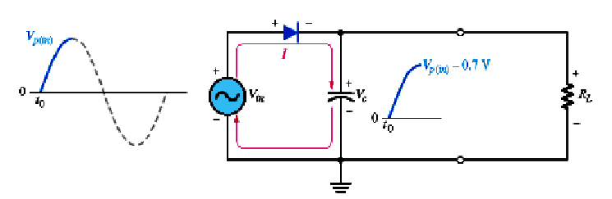
Capacitor Filter
During the positive first-quarter cycle of the input, the diode is forward-biased, allowing the capacitor to charge to within 0.7V of the input peak

Slide 5
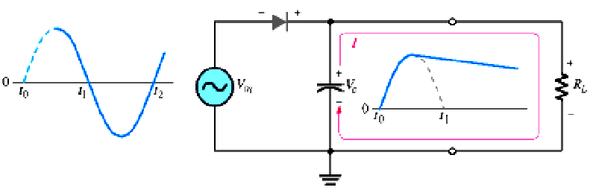
When the input decreases below its peak, the capacitor retains its charge and diode becomes reverse-biased because the cathode is more positive than the anode.
Capacitor discharges only through the load resistance at a rate determined by the R_{L}C time constant (normally long)
The larger the time constant, the less the capacitor will discharge.

Slide 6
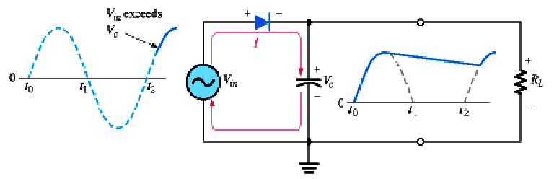
During the first quarter of the next cycle, the diode will again become forward-biased when the input voltage exceeds the capacitor voltage by approximately 0.7

Slide 7
Ripple Voltage
The capacitor charges at the beginning of each cycle
It slowly discharges through R_{L} after the positive peak (when diode is reverse-biased).
The variation in the capacitor voltage due to the charging and discharging is called the ripple voltage.
Ripple is undesirable. The smaller the ripple, the better the filtering action is.

Slide 8
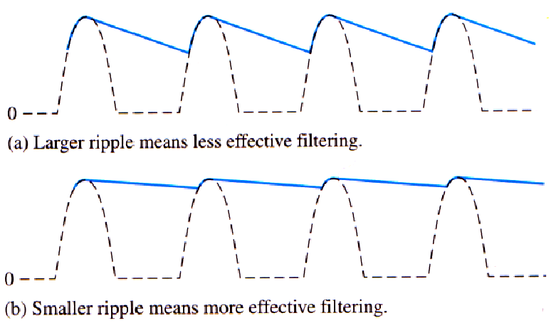
Half-wave ripple voltage (solid line)

Slide 9
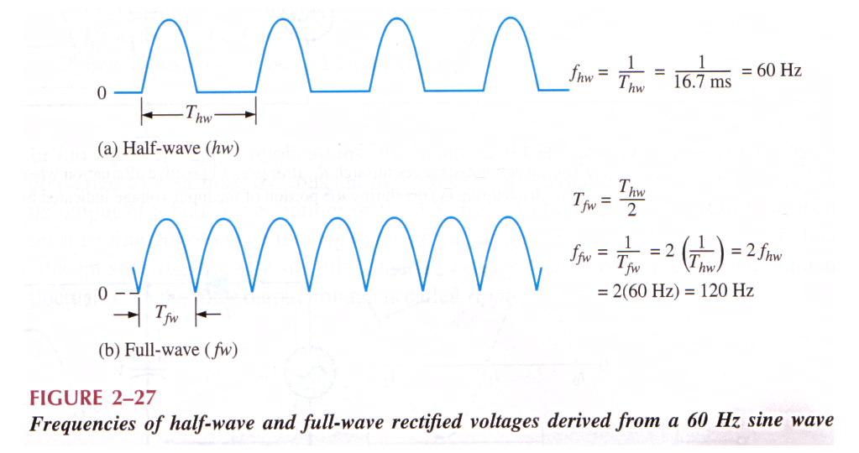
Ripple Frequency
For a given input frequency, the output frequency of full-wave rectifier is twice that of a half-wave rectifier

Slide 10
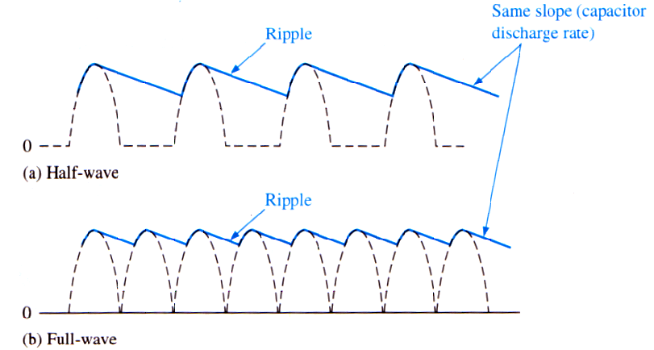
When filtered,the full-wave rectified voltage has a smaller ripple than a half-wave voltage for the same load resistance and capacitor values

Slide 11
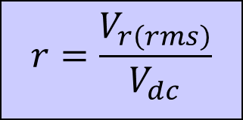
Ripple Factor
The ripple factor ( r ) is an indication of the effectiveness of the filter.
It is defined as
Where V_{r}(rms) is the rms of the ripple voltage and V_{dc} is the dc (average) value of the filter’s output voltage.
$$r=\frac{V_{r\left(rms\right)}}{V_{dc}}$$
V_{r(pp)}
V_{p(rect)}
V_{DC}

Slide 12
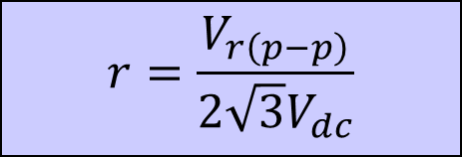
Ripple Factor
The ripple voltage V_{r}(rms) can be derived by approximating the ripple waveform to a triangular shape.
Hence the factor √3 to the equation:
$$r=\frac{V_{r\left(p−p\right)}}{2\sqrt{3}V_{dc}}$$
Where V_{r(p-p)} is the peak to peak ripple voltage.
The lower the ripple factor, the better the filter.
The ripple factor can be lowered by increasing the value of the filter capacitor or increasing the load resistance
V_{r(p-p)}
V_{p(rect)}
V_{DC}

Slide 13
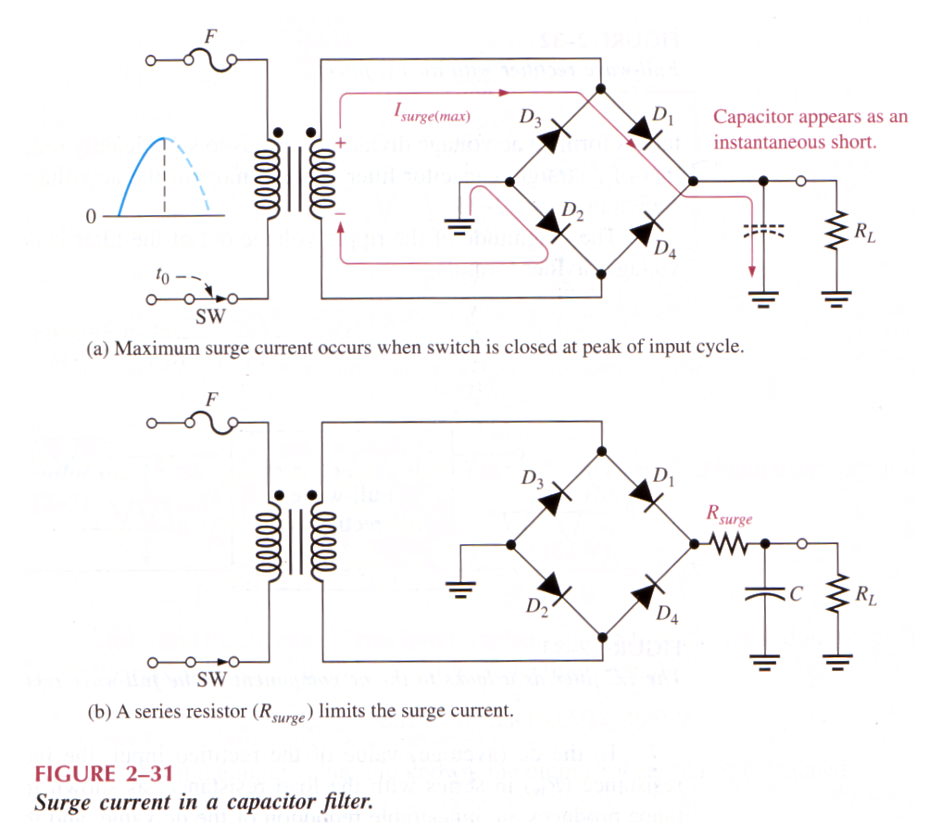
Surge Current in the Capacitor Filter
Before the switch is closed, the filter capacitor is uncharged.
At the instant the switch is closed, voltage is connected to the bridge and the uncharged capacitor appears as a short.
This produces an initial surge of current I_{surge} through the two forward-biased diodes D₁ and D_{2.}

Slide 14
A surge-limiting resistor is sometimes used to protect the diodes
The value of this surge-limiting resistor must be small compared to the R_{L}
Diodes must have a maximum forward surge current rating that can withstand momentary surge of current – specified as I_{FSM}
Minimum surge value:

Slide 15
Summary
A capacitor filter can provide a dc output voltage that is slightly less than the peak voltage at its input.
The charging and discharging of the filter capacitor result in a ripple voltage being produced. The smaller the ripple voltage, the better is the filter.
The smaller the ripple factor, the better is the filter.

Slide 16
End of Chapter 19 (Part 2)

